Slide 1
Research- Case Studies Identification
31-Aug-2018
Pune
Pratik Shirbhate
pratikshirbhate@gmail.com
+91 7588809138

Slide 2
How do I identify relevant use cases?
New to the Data Science/Analytics Field
Don’t know how to start!
Research! Research! Research
Analyze how data scientists are contributing in healthcare domain
White papers may not be available
Gather/study research papers and reproduce the results
Science-Direct, Elsevier, Academia.edu
Data not available

Slide 3
How do I get the Data?
Have you already identified the problem?
Have your found high level idea to approach to the solution
Where do I get the data?
Get publically available related data from Kaggle, UCI Machine Learning Repository, Data.gov, Data USA, github

Slide 4
Approach
Data Visualization
Data Access
Data Analysis
Data Understanding
Data Integration
Formatting, Cleaning
Storage
Data

Slide 5
Use Case 1- Predict Drug Demand
Demand Forecasting in Pharmaceutical Industry Using Artificial Intelligence: Neuro-Fuzzy Approach
In this study, the actual sales amounts of a pharmaceutical company for seven years period were considered in order to forecast next period’s demands
Determine which products are purchased, where, when, and in what quantities
Researches will not share the data for various reasons
Obtain a sample sales data
Kaggle.com
Synthesize the data based on your needs
This study will help to improve the sales and formulate better marketing strategies

Slide 6
Use Case 2- Predict DME Demand
Extension of use case 1
Identify DME Claims data- Claims explorer
Find pattern in the data
Identify regions where sales of DME was high/low
Forecast the sales and develop marketing strategies
Reinforcement learning-→ Which DMEs are often bought together-→ Give them discount

Slide 7
Use Case 3- Claim Review Prioritization
As of July 2017, HCCI held approximately 1 billion commercial medical and pharmacy claims per year
The finding showed that out of these 1 billion claims submitted, around nine percent of claims were initially denied
5 Million Medical claims are Audited
Random Sampling-→ Not optimal solution
Develop strategy by analyzing denied claims data/pattern
Identify potential claims that are more prone to incorrect denial/over payment/underpayment and route them to auditing systems

Slide 8
Use Case 4- Medical Claim Fraud Detection
IEEE Paper
According to a recent survey, it is estimated that the number of false claims in the industry is approximately 15 per cent of total claims
Insurance companies in USA incur losses over 30 billion USD annually to healthcare insurance frauds
Healthcare frauds are not obvious and thus difficult to detect-→ Anomaly Detection
Don’t have access to read full text
Don’t have data
Get paid access to IEEE in order to get access to all paper

Slide 9
Examples of healthcare fraud by health care providers and patients
Providers:
Billing for services not provided
Administering (more) tests and treatments or providing equipment's that are not medically necessary
Administering more expensive tests and equipment's (up-coding)
Multiple-billing for services rendered
Unbundling or billing separately for laboratory tests performed together to get higher reimbursements
Charging more than peers for the same services
Conducting medically unrelated procedures and services
Policy holders
Traveling long distance for treatment which may be available nearby. (Possibly scams by bogus providers.)
Letting others use their healthcare cards

Slide 10
Statistical healthcare fraud detection techniques
Total amount billed
Total number of patients
Total number of patient visits
Per-patient average billing amounts
Per-patient average visit numbers
Per-patient average medical tests
Per-patient average medical test costs
Per-patient average prescription ratios (of specially monitored drugs)

Slide 11
What we can do?
Develop Predictive models that can predict potential fraudulent claims and providers.
Problem: Difficult to obtain training historical data as most fraudulent claims may have not been discovered!
Predictive modeling tips:
Large neural networks with a large number of input and hidden nodes lead to overfitting.
Large networks, especially with small training datasets, can remember individual records. This is no good predictive model.
A better way is to decompose problems into multiple smaller neural networks with a small number of input and hidden layer nodes, each network predicting one type of frauds.

Slide 12
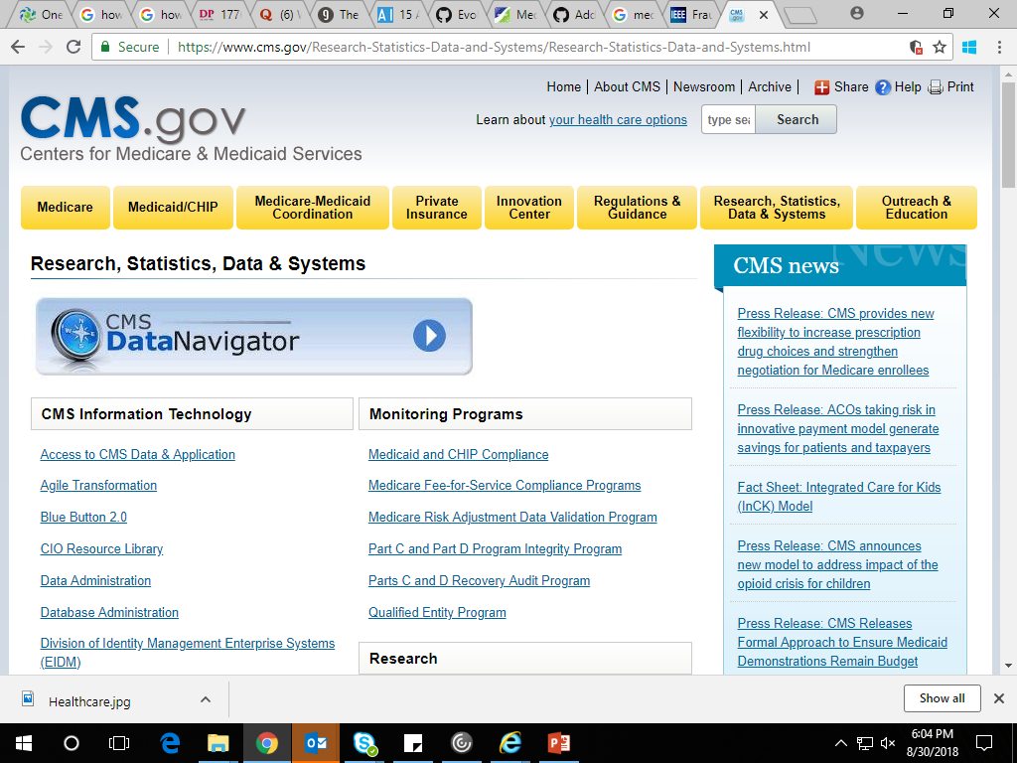
Use Case 4- Claim Price Prediction
Predict medical claim price based on Procedure code and Diagnosis code
Obtain data from United States’ Centers for Medicare & Medicaid Services (CMS) website

Slide 13
Research Paper
Analyzing health insurance claims on different timescales to predict days in hospital
Algorithmic Prediction of Health-Care Costs
Data Mining to Predict and Prevent Errors in Health Insurance Claims Processing

Slide 14
Use Case 5- Provider/Sales Agent Performance Prediction
Obtain Sales data--- data extract of IDV/ any other agent tool
Analyze the success rate
Research paper t study and implement to solve our case study
Explaining machine learning models in sales predictions

Slide 15
Use Case 6- Market Segmentation
Cluster sales of various medical plans demographically
Research Papers
A New Approach to Segmentation for the Changing Insurance Industry
Why Health Insurance Companies Should Use Psychographic Segmentation in 2018

Slide 16
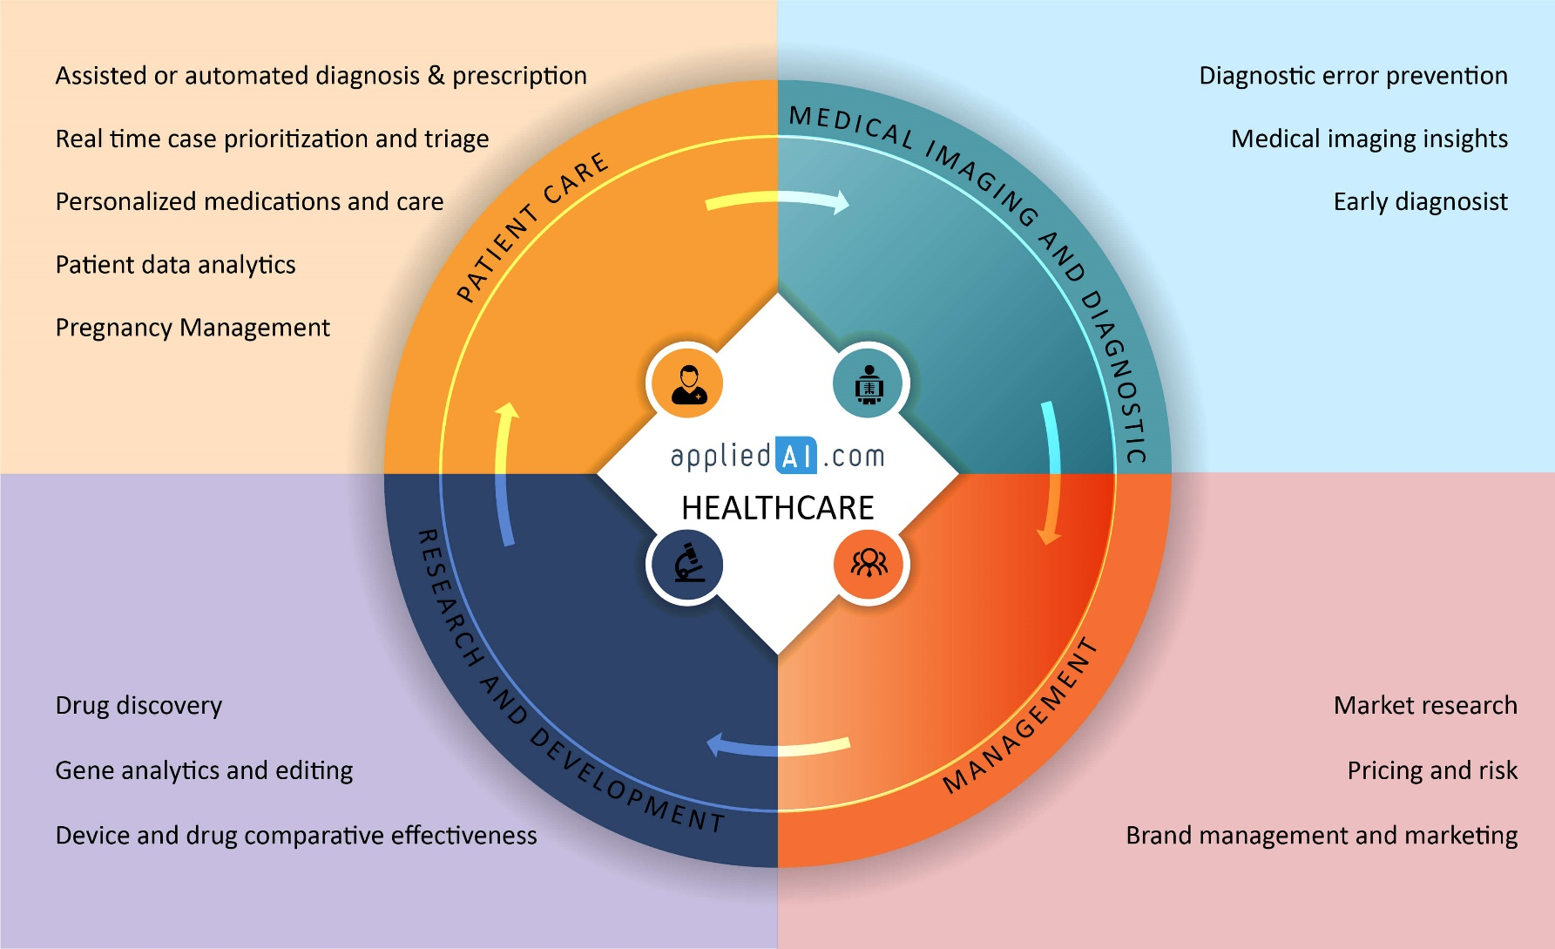
15 AI Applications / Usecases in Healthcare [2018 update] Source-https://blog.appliedai.com/healthcare-ai/

Slide 17
Thank you

